Slide 1
Lotka Volterra with PySyndi
Yash Lal

Slide 2
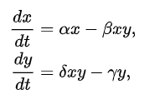
Setup
Assumed beta=delta
Swept through 567 parameter sets
Alpha in [1,9], step=1
Beta=Delta in [1,1.7], step=0.1
Gamma in [1,9], step=1
Trained from IC of [5,5]
Training data was integrating by dt=0.01 from t=0 to 100
Fit model
Testing from IC of [10,10]
Training data for validation was integrating by dt=0.01 from t=0 to 100

Slide 3
Results
Parameter sweep was chosen to avoid extinctions
Numerical error from the solver pollutes the data
Average testing accuracy: 99.38%
Some cases had small coefficients on terms that shouldn’t exist (i.e., y^2)
Nothing too significant
Accuracy is better when parameters were smaller
One wacky PySyndi breakdown:
If alpha:beta:delta:gamma was in ratio 1:0.2:0.2:1 i.e., 8:1.6:1.6:8
“UserWarning: Sparsity parameter is too big (0.1) and eliminated all coefficients”
I’m not too worried about this happening in the future

Slide 4
Results
Changing the type of time series
Time step of the integrator was fixed at 0.01 but training and testing data was taken by selecting every 10th/100th data point
(Dense): [0,10] with step=0.01: Acc=0.9938
Even [0,1] with step-0.01 gives Acc=0.9929
(Wide): [0,100] with step=0.1: Acc=0.6578
Wide data does much worse
Hypothesis: losing the idea of the “neighborhood” of points

Slide 5
Testing PySyndi
Yash Lal

Slide 6
Setup
Use multiple trajectories
Wider data
5 trajectories spaced from [0,0] to [50,50]
dt=0.1 in [0,20] for sampling data
Testing on 1 trajectory

Slide 7
Oscillations
Simple Harmonic Motion and Damped Harmonic Motion
Success (Acc > 95%, accurate vector field)
Worked with ranging parameters
As well as quadratic and (sort of for cubic damping)
Acc decreases slightly as power of damping term increases
Higher order => harder to learn

Slide 8
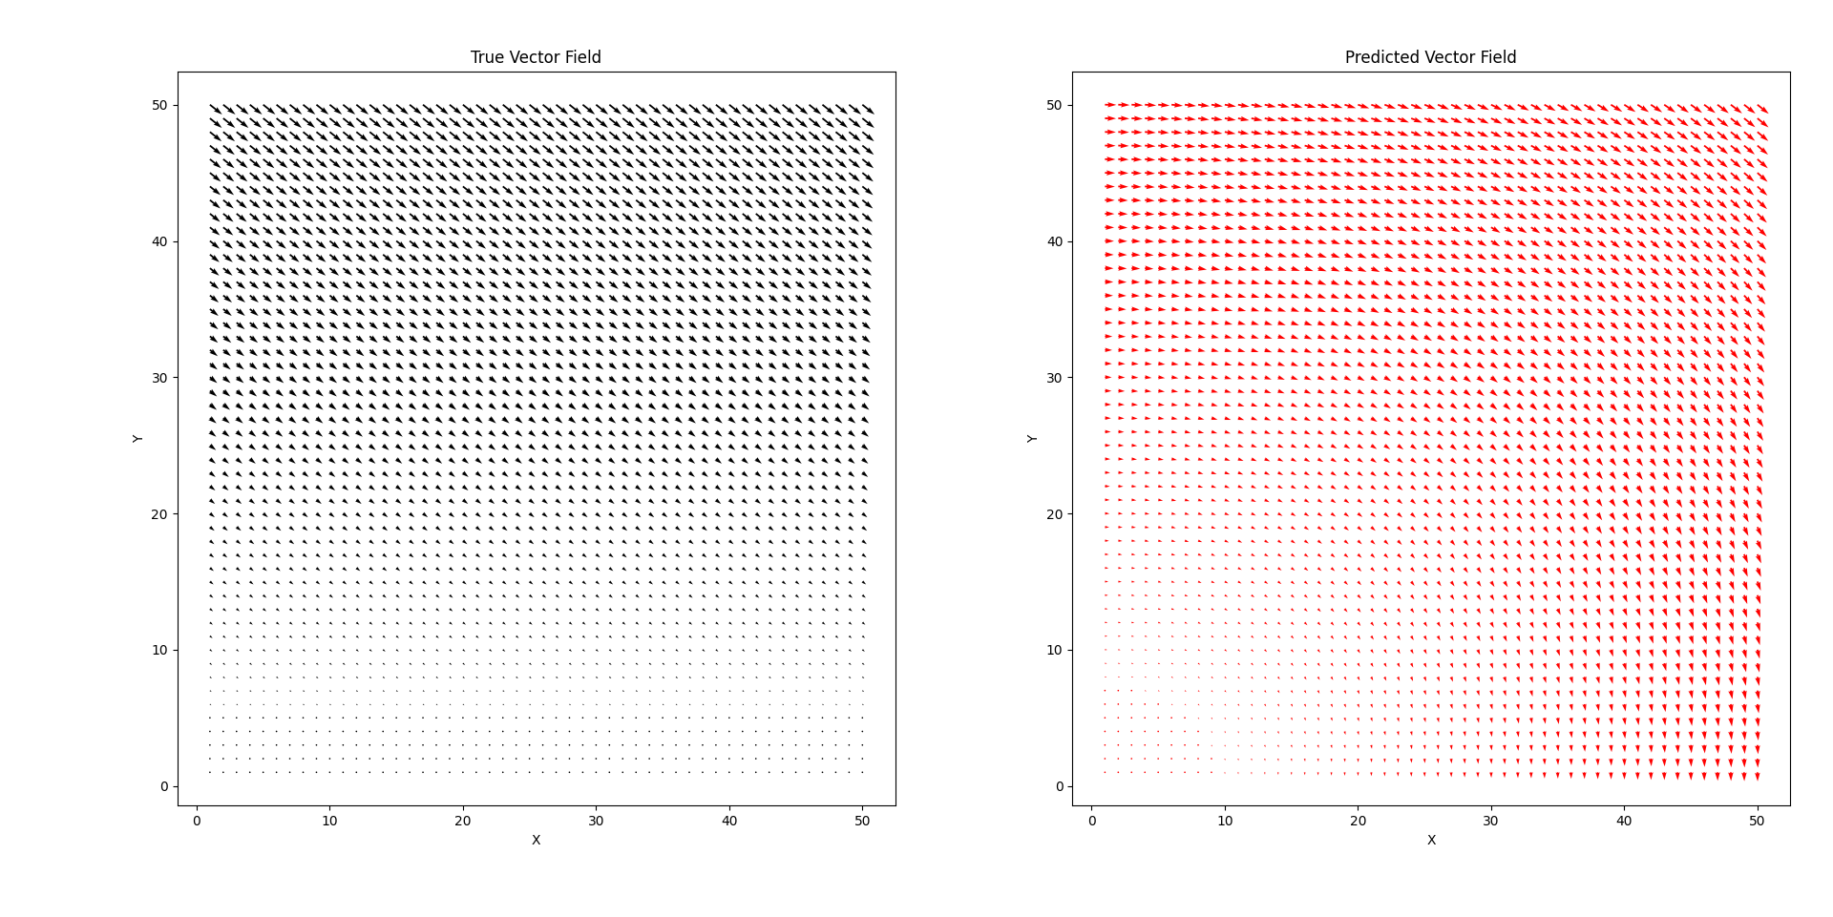
SHM

Slide 9
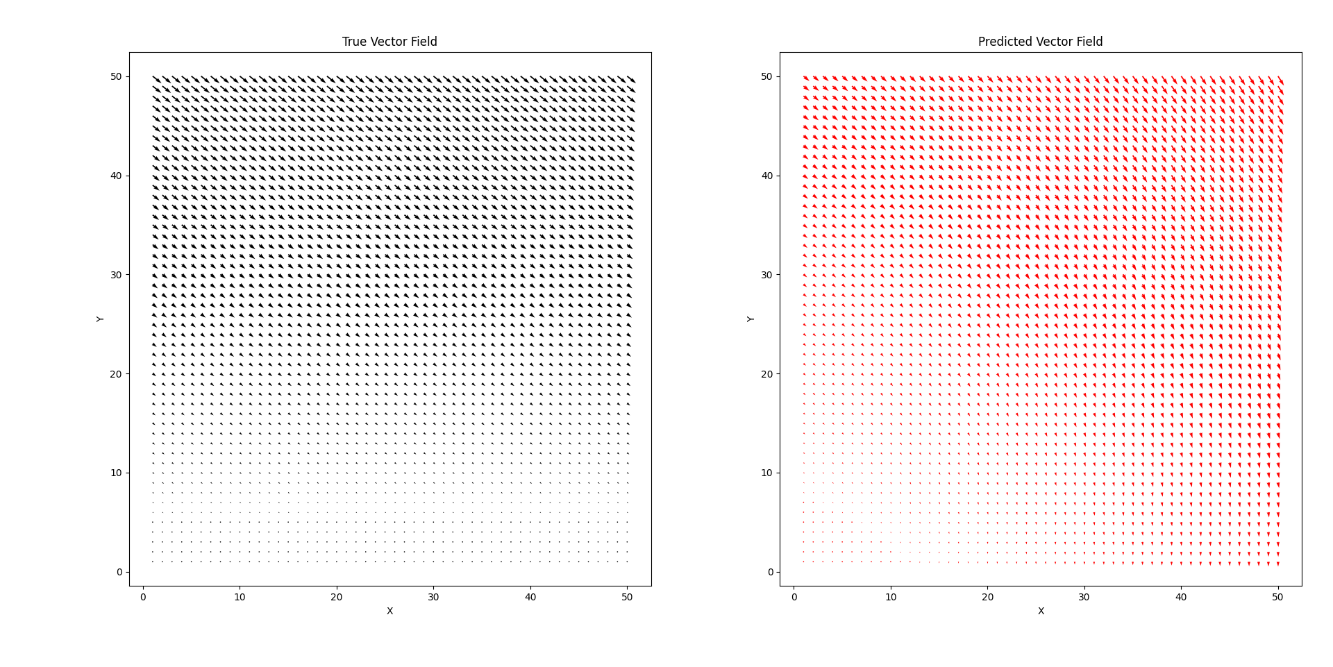
DHM

Slide 10
Exponential Growth and Decay
“UserWarning: Sparsity parameter is too big (0.1) and eliminated all coefficients”
If decay/growth is too slow, this occurs
Pops up in random places
Success for small decay/growth rates
Breaks down with very fast exp decay/growth
Overfitting occurs and acc declines

Slide 11
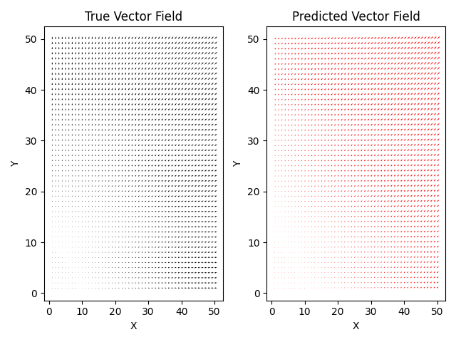
Growth

Slide 12
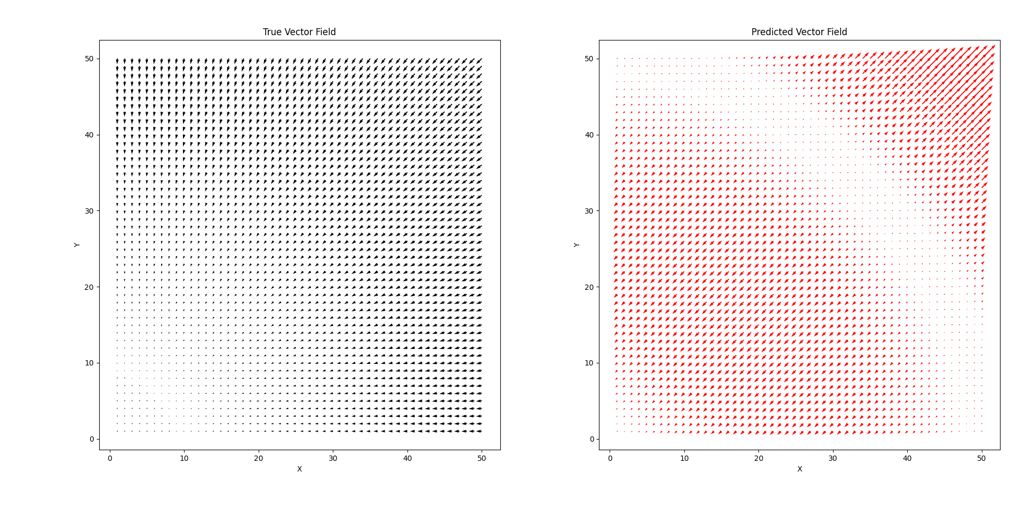
Rapid Decay Failure

Slide 13
Linear and Nonlinear 2D
dx = ax^n+by^n and dy=cx^n+dy^n
For n=1:
Success in acc >95% (ignoring sparsity errors)
As n increases, hard to find data without numerical instability
Harder to predict too as before
Pockets of stability

Slide 14
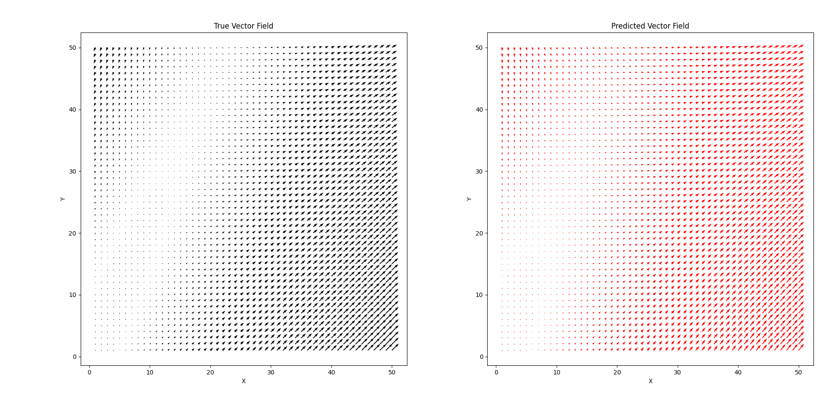
2D Linear

Slide 15
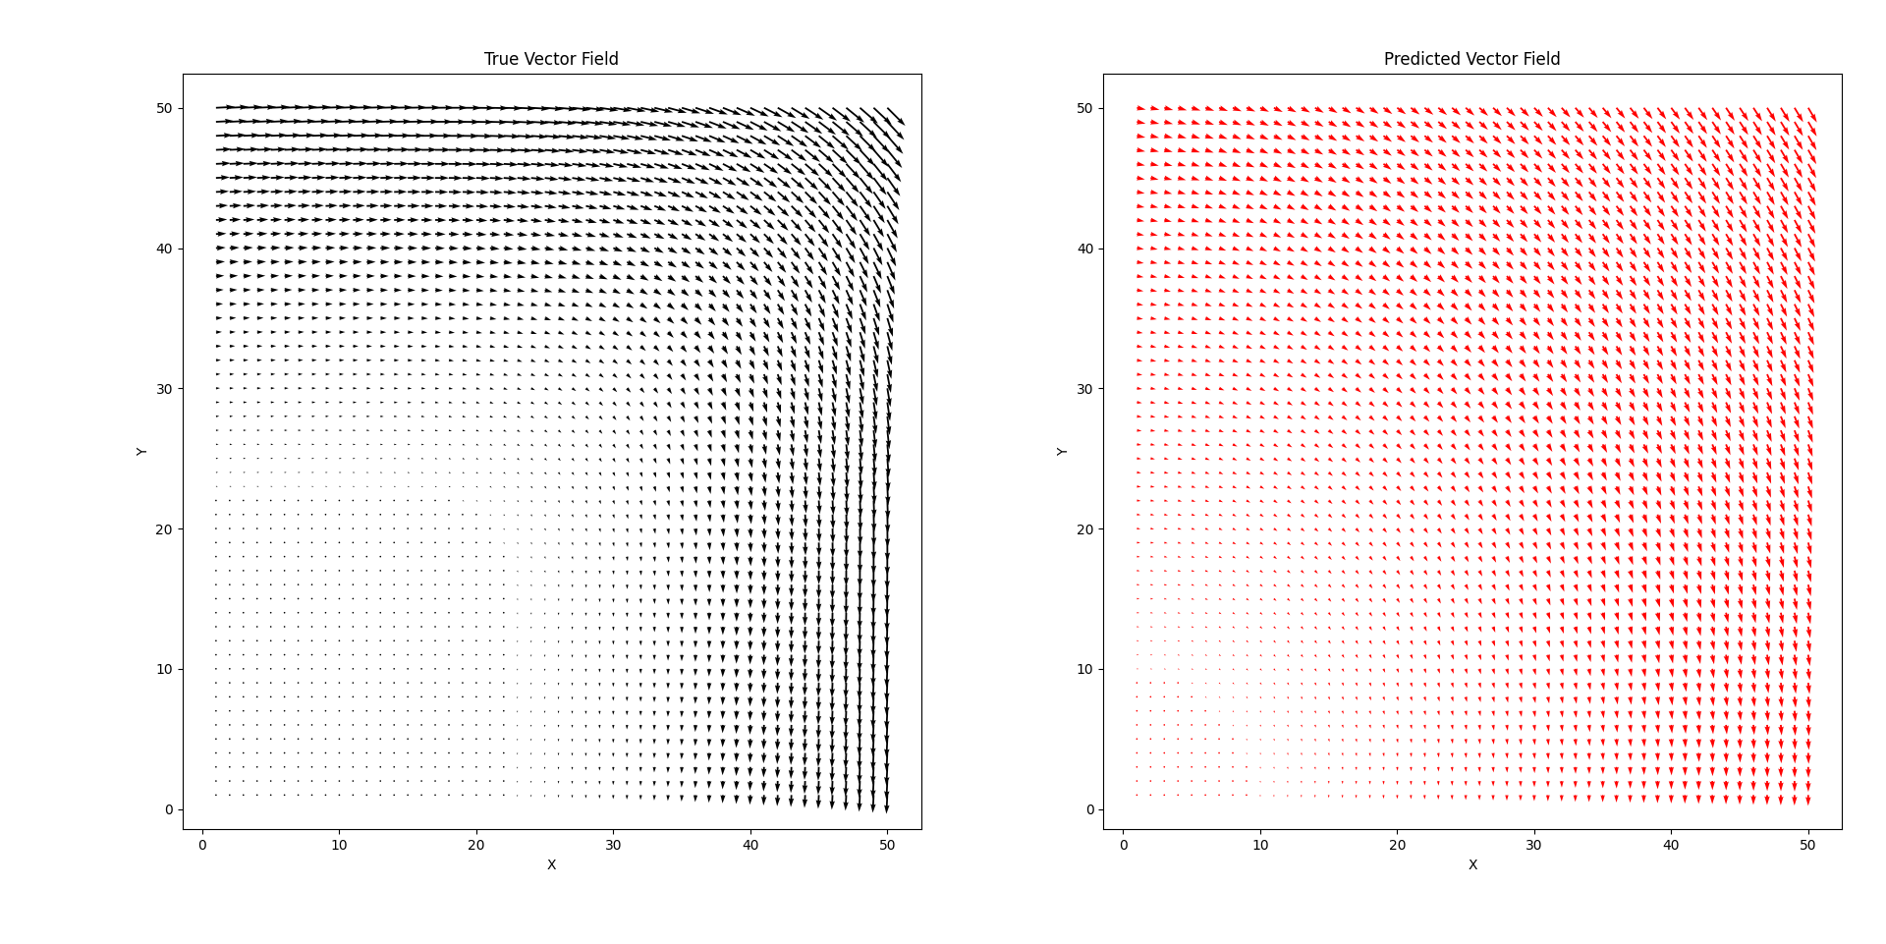
2D Cubic Coupled

Slide 16
From the Paper…
Lorenz Equations
Nonlinear cubic coupled ODEs
Complex fluid flow
Logistic Map

Slide 17
Thoughts
Data can be finicky and lead to errors if too sparse
More trajectories seem to help
Compensate for wider data
Battle between amount of data vs density of data
Higher order terms mess with data
Either seem to get pretty wrong or pretty correct
Except for cases where overfitting seems to seep away the accuracy

Slide 18
Cool Plots
Yash Lal

Slide 19
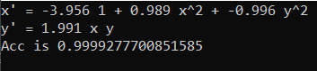
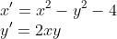
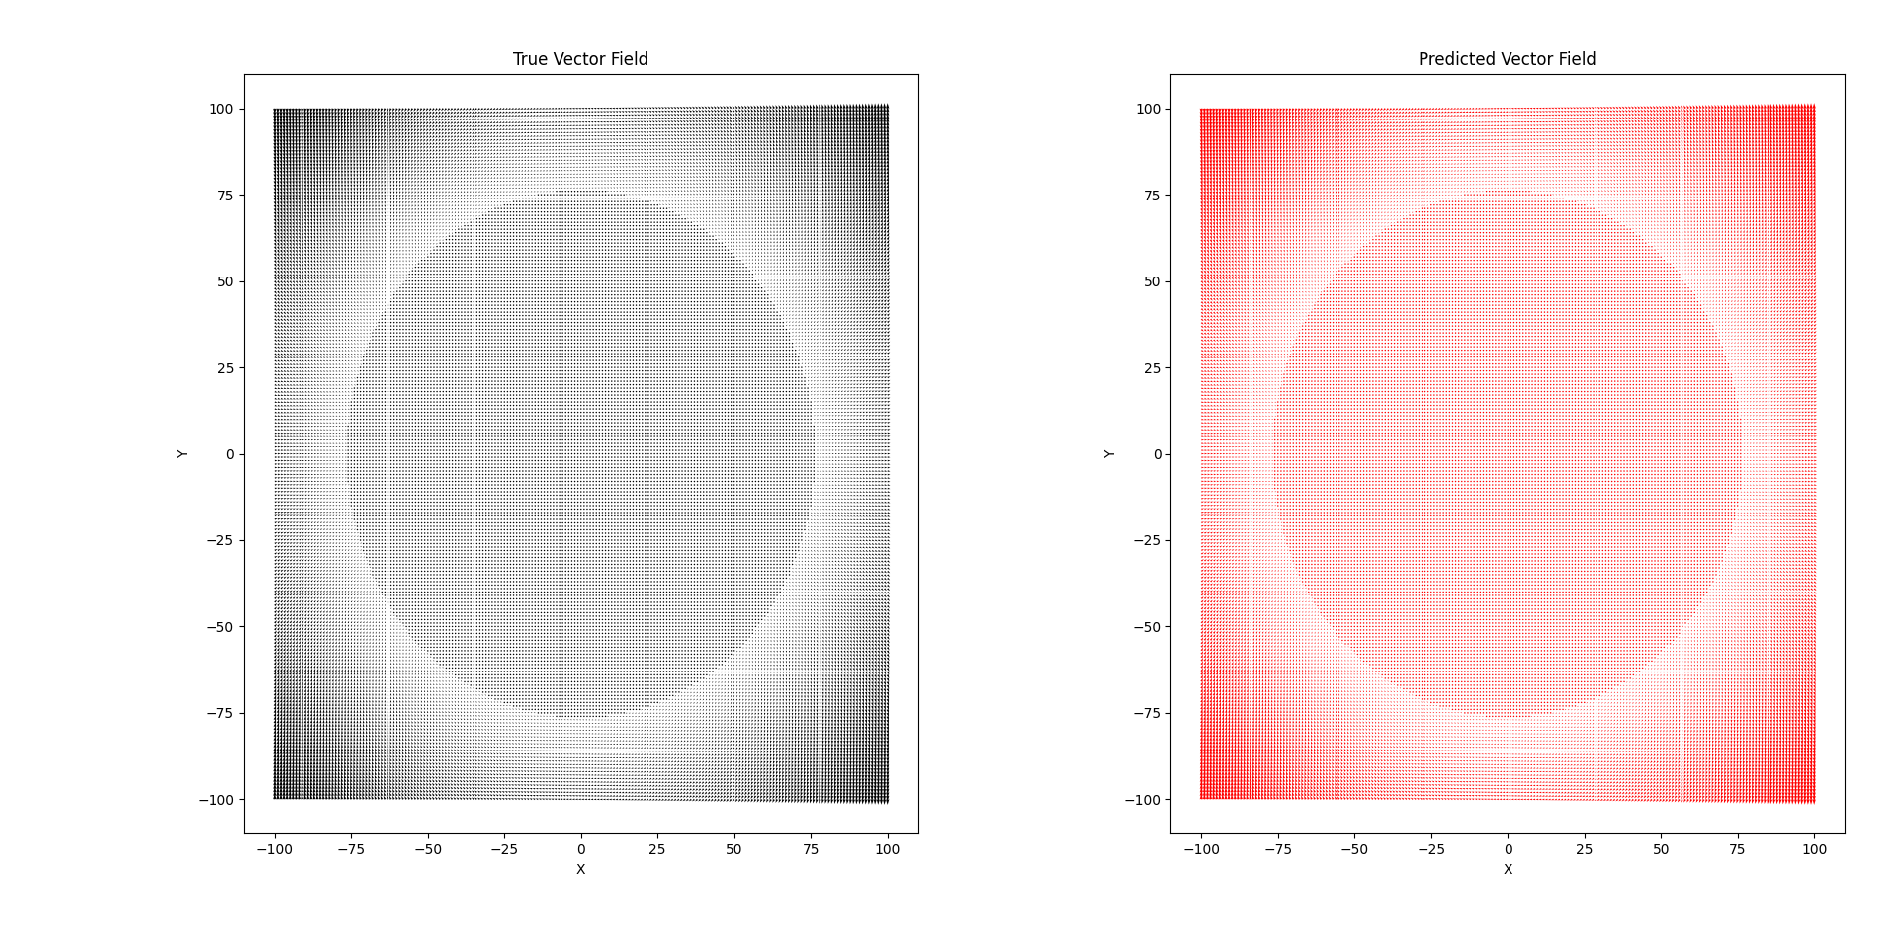

Slide 20
